Slide 1
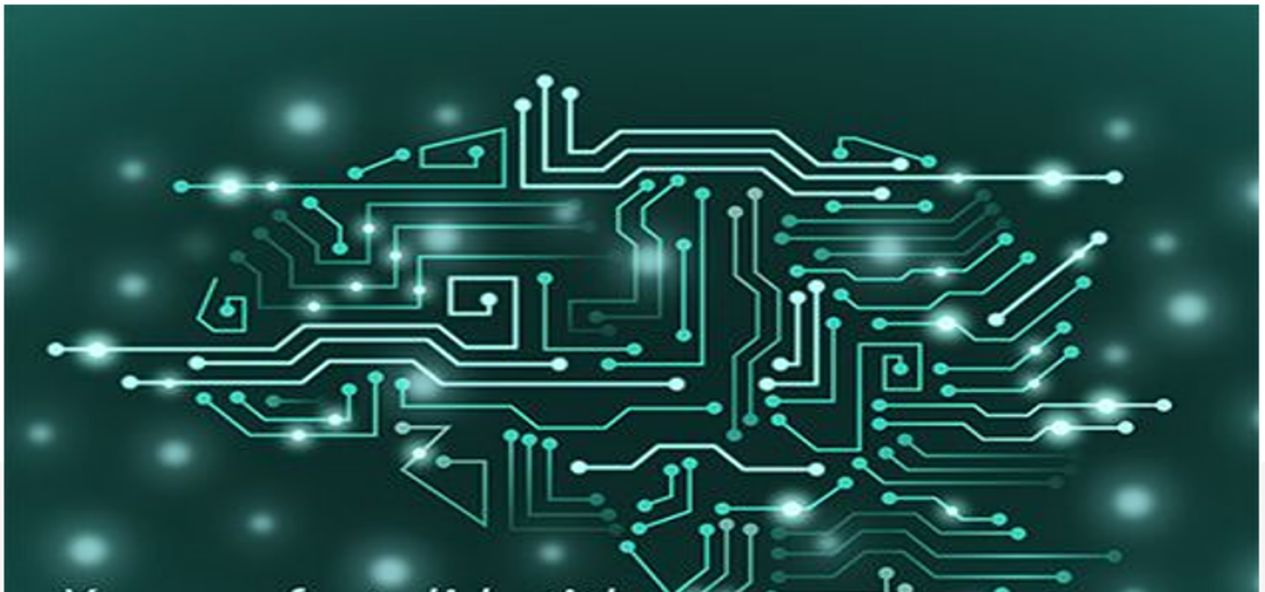
Machine Learning Introduction & Clustering
By K. Igwe 2021

Slide 2
Lesson Objectives
Define Machine Learning(ML)
Applications of ML
Origins
ML vs Traditional Programming
Interdisciplinary field
Supervised vs. Unsupervised
Classification vs. Clusturing
Clusturing- K-Mean

Slide 3
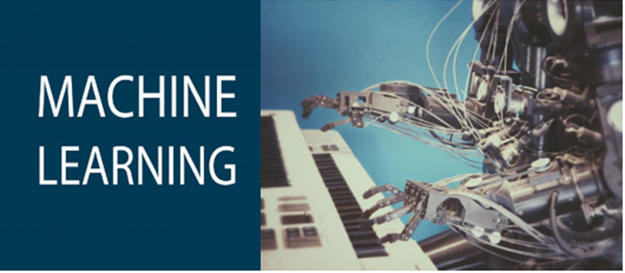
What is Machine Learning
“Machine Learning is the science of getting computers to learn and act like humans do, and improve their learning over time in autonomous fashion, by feeding them data and information in the form of observations and real-world interactions.”

Slide 4
What is Machine Learning
“Machine Learning at its most basic is the practice of using algorithms to parse data, learn from it, and then make a determination or prediction about something in the world.” – Nvidia
“Machine learning is the science of getting computers to act without being explicitly programmed.” – Stanford
“Machine learning is based on algorithms that can learn from data without relying on rules-based programming.”- McKinsey & Co.
“Machine learning algorithms can figure out how to perform important tasks by generalizing from examples.” – University of Washington

Slide 5
What is Machine Learning
“How do we create computer programs that improve with experience?"
Tom Mitchell
“A computer program is said to learn from experience E with
respect to some class of tasks T and performance measure P, if
its performance at tasks in T, as measured by P, improves with
experience E. "
Tom Mitchell. Machine Learning 1997.

Slide 6
ML vs Traditional Programming
Rules
Traditional Programming
Answers
Data
-Explicity Programming
-Use rules to get the Answers
-In traditional programming, the inputs of hard-coded rules and data are used to arrive at the output of answers, but in machine learning the approach is quite different.

Slide 7
ML vs Traditional Programming
Answers
Machine Learning
Rules
Data

Slide 8
Data Types in Statistics and ML
a very good understanding of the different data types is a prerequisite for doing Exploratory Data Analysis (EDA).
Why?
certain statistical measurements are only used for specific data types
Useful to determine the right visualizations for your data

Slide 9
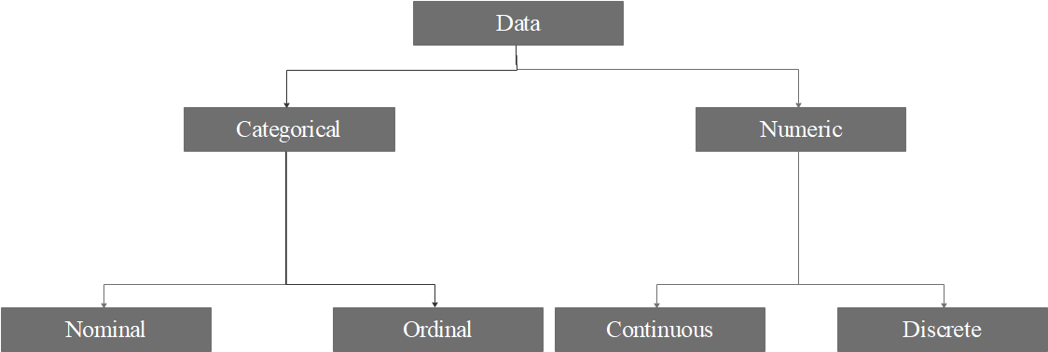
Data Types in Statistics and ML
Data: unprocessed facts that you collect through your study

Slide 10
Categorical Data
Categorical data: Often represent characteristics such as a person’s gender, country, Yes/No, etc.
Categorical Ordinal: Ordered in some way that makes sense
Strongly Disagree, Disagree, Neither agree nor disagree, Agree, Strongly Agree
Categorical Normal: has no order
Male, Female
Yes, No,
South Africa, USA, Kenya, Nigeria

Slide 11
Numerical Data
Numerical data: Have meaning as a measurement or count
Continuous : The values cannot be counted and can only be described using intervals on the real number line.
Person’s height, age, etc
Discrete: Items that can be counted; they take on possible values that can be listed out.
How many heads in 50 coin flip?

Slide 12
Origins of ML
Data everywhere
Recorded data
Explosion of recorded data – electronic sensors
Governments
Businesses
Individuals
Era of Big Data
Computational Power

Slide 13

Applications of ML
We all use it on a daily basis. Examples:

Slide 14
Machine Learning Applications
Spam filtering
Credit scoring
Credit card fraud detection
Digit recognition on checks, zip codes
Detecting faces in images
MRI image analysis
Recommendation system
Search engines
Handwriting recognition
Scene classification
etc...

Slide 15
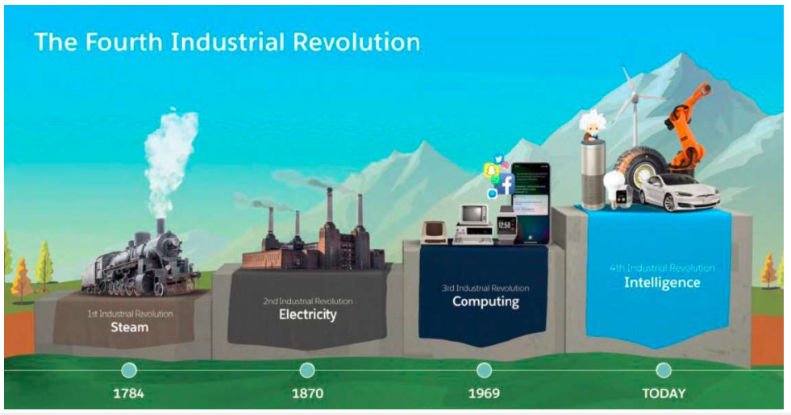
4IR

Slide 16
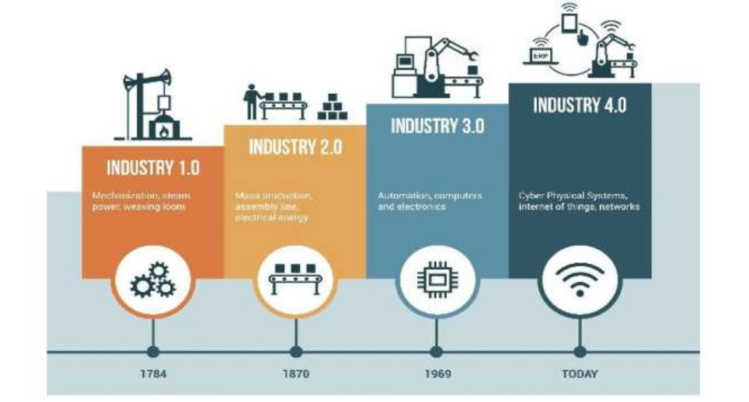
4IR

Slide 17
Artificial Intelligence(AI)
Artificial Intelligence (AI), is man made intelligence using machines and software designed to perform given task and mimic the thinking process of a human being.

Slide 18
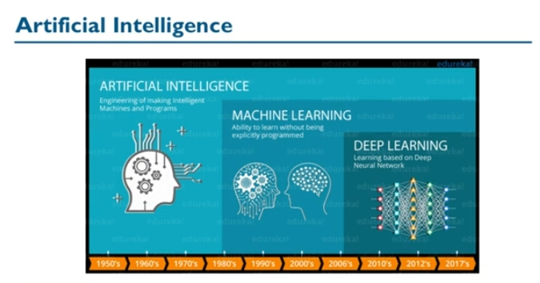
AI vs ML

Slide 19
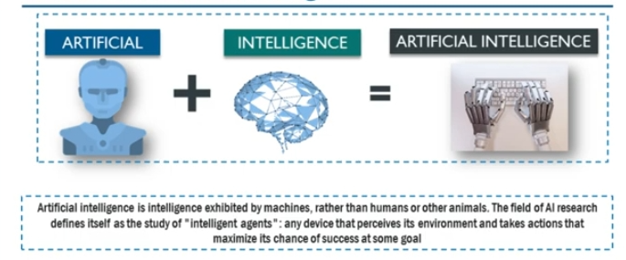
AI

Slide 20
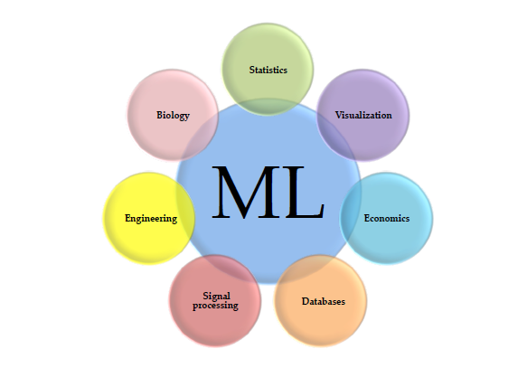
Interdisciplinary field

Slide 21
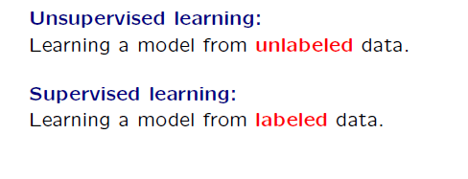
Supervised vs. Unsupervised
Its all about how the DATA looks/appear

Slide 22
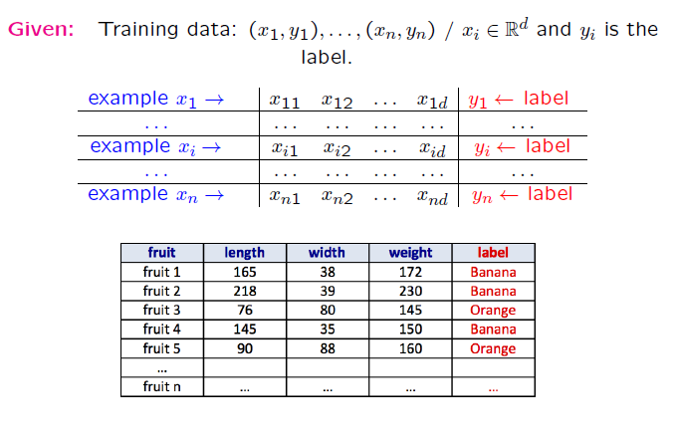
Supervised

Slide 23
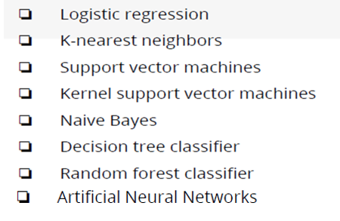
Supervised Learning Algorithms

Slide 24
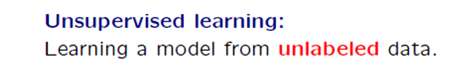
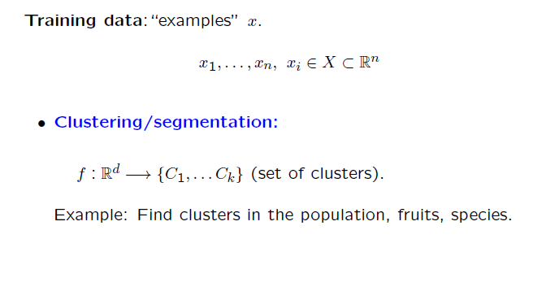
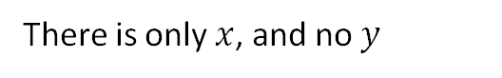
Unsupervised Learning
There is only $x$, and no $y$

Slide 25
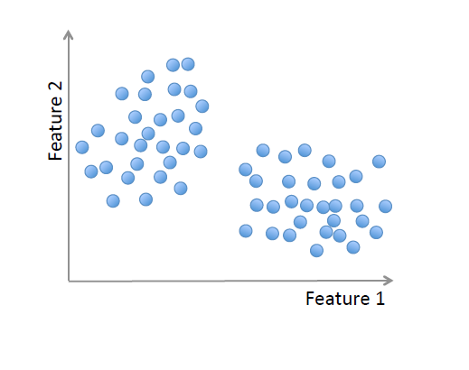
Unsupervised learning

Slide 26
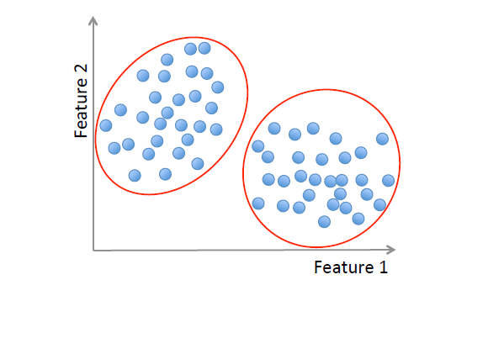
Unsupervised learning

Slide 27
Unsupervised learning
Methods:
K-means,
Gaussian mixtures,
Hierarchical clustering,
Spectral clustering,
Advanced clustering methods
Hybrid clustering methods
Fuzzy clustering
Model-based clustering
DBSCAN: Density-based clustering
etc.

Slide 28
Classification
Classification is a form of machine learning where two or more distinct groups, or classes, of things are known ahead of time(pre-defined) and used to group additional things.
The features of members of each class are analyzed or learned, and then generalized to build an understanding of what it means to be a member of each class.
The generalizations are then compared with potential new member and used to “classify” each into the best fitting class. The result is a classification of each of the new members into one of the pre-defined classes.
Classification is an example of supervised learning because classes are known.

Slide 29
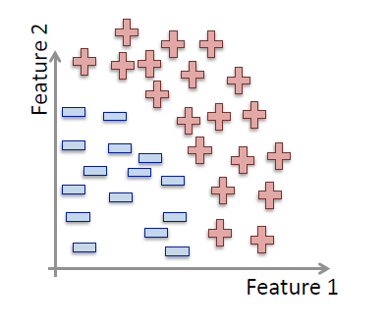
Classification

Slide 30
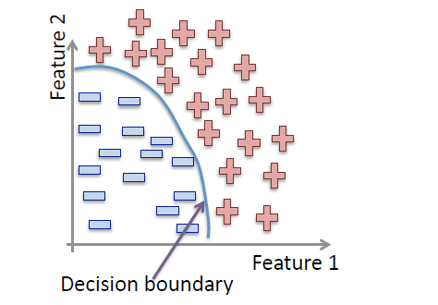
Classification

Slide 31
Classification Algorithms

Slide 32
Clustering
Clustering is a form of machine learning where groups, or classes, are not known ahead of time so groupings are created by looking at similar and shared characteristics among the things being grouped. (homogeneous groups)
Given a set of potential class members, the task of clustering is to establish the existence of two or more classes or clusters in the members.
These clusters are often determined through trial and error by
grouping things together by looking for similar features, analyzing the results to see how good they are, and repeating this learning process until the groups are deemed acceptable.
Clustering is an example of unsupervised learning because classes are unknown at
the start.

Slide 33
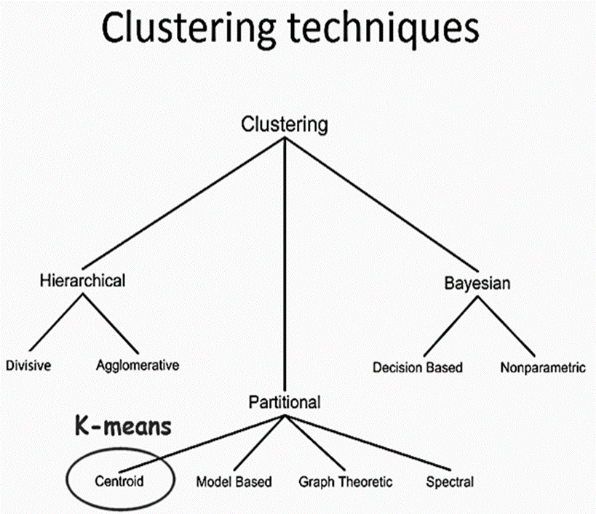
Clustering Techniques

Slide 34
Clustering /Segmentation

Slide 35
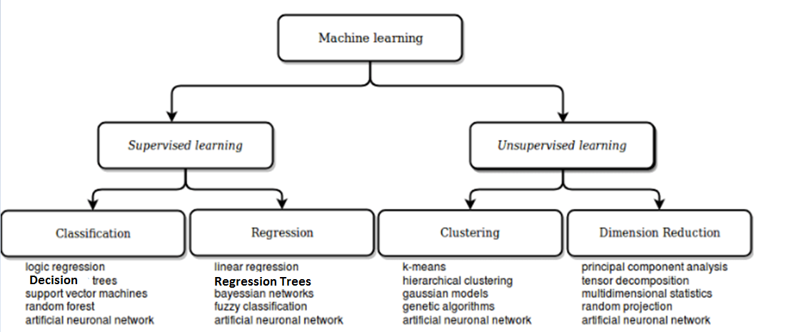
Summary

Slide 36
THANK YOU
/belgiumcampusSA
#Belgium Campus
info@belgiumcampus.ac.za
+27 10 593 53 68
/belgiumcampus

Slide 37
Quiz
Quiz
Quiz
Quiz
Quiz
Quiz
Quiz
Quiz

Slide 38
MLG381: MACHINE LEARNING K-Means Clustering

Slide 39
Lesson Objectives
Introduction to Clustering
History of Clustering
Clustering Techniques
K-Means Clustering
Examples and Exercises

Slide 40
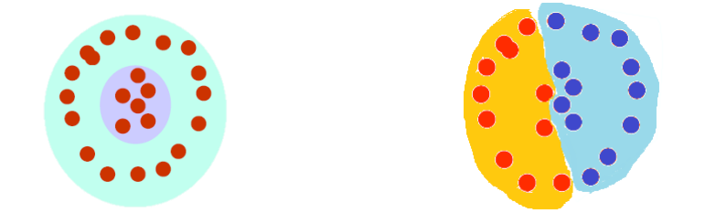
Introduction
The organization/segmentation of unlabeled data into similarity groups called clusters.
A cluster is a collection of data items which are “similar” between them, and “dissimilar” to data items in other clusters.

Slide 41
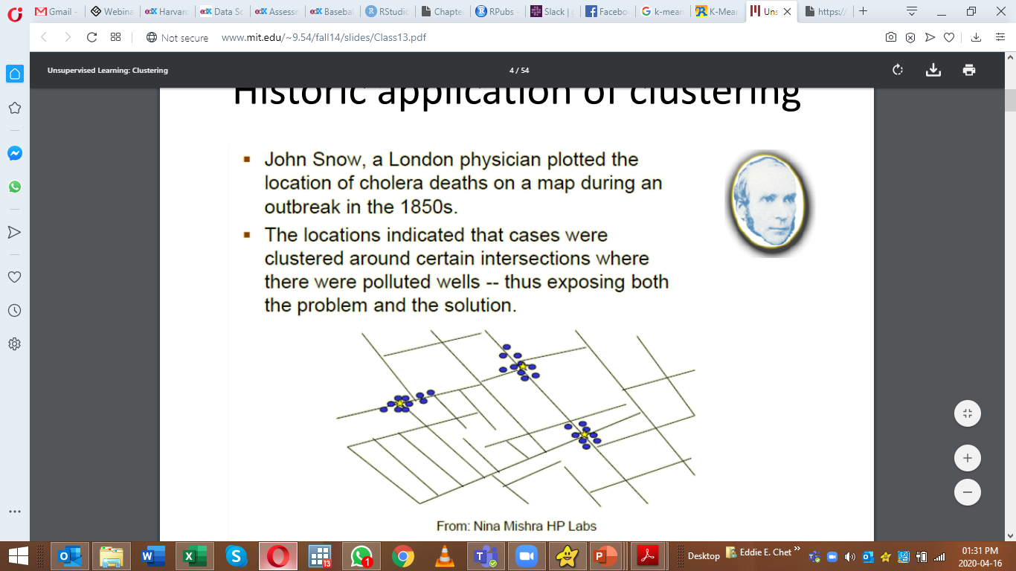
Historical Application of Clustering
John Snow, a London physician plotted location of cholera deaths on a map during an outbreak in 1850s.
Locations indicated that cases were clustered around certain intersections where there were polluted wells;
thus exposing both the problem and the solution.

Slide 42
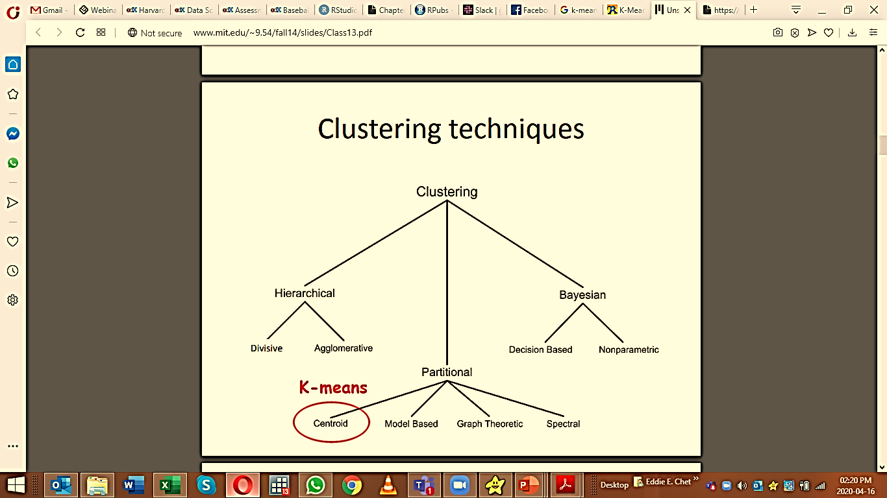
What do we need for Clustering?
Required:
Proximity measure.
Criterion function to evaluate a clustering.
Algorithm to compute clustering.

Slide 43
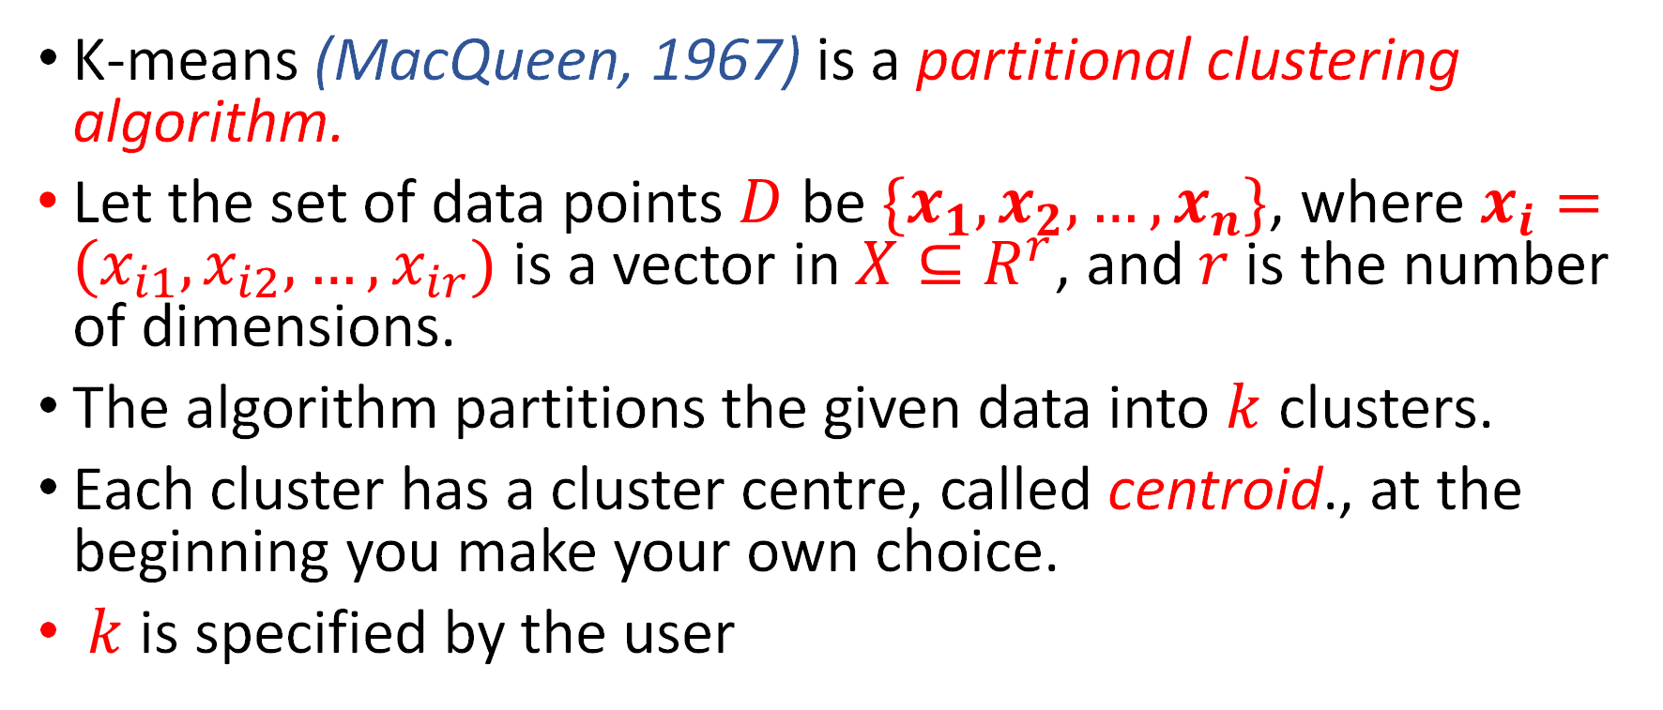
K-Means Clustering
K-means (MacQueen, 1967) is a partitional clustering algorithm.
Let the set of data points $D$ be $\{x_{1},x_{2},…,x_{n}\}$, where $x_{i}=(x_{i1},x_{i2},…,x_{ir})$ is a vector in $X⊆R^{r}$, and $r$is the number of dimensions.
The algorithm partitions the given data into $k$ clusters.
Each cluster has a cluster centre, called centroid., at the beginning you make your own choice.
$k$ is specified by the user

Slide 44
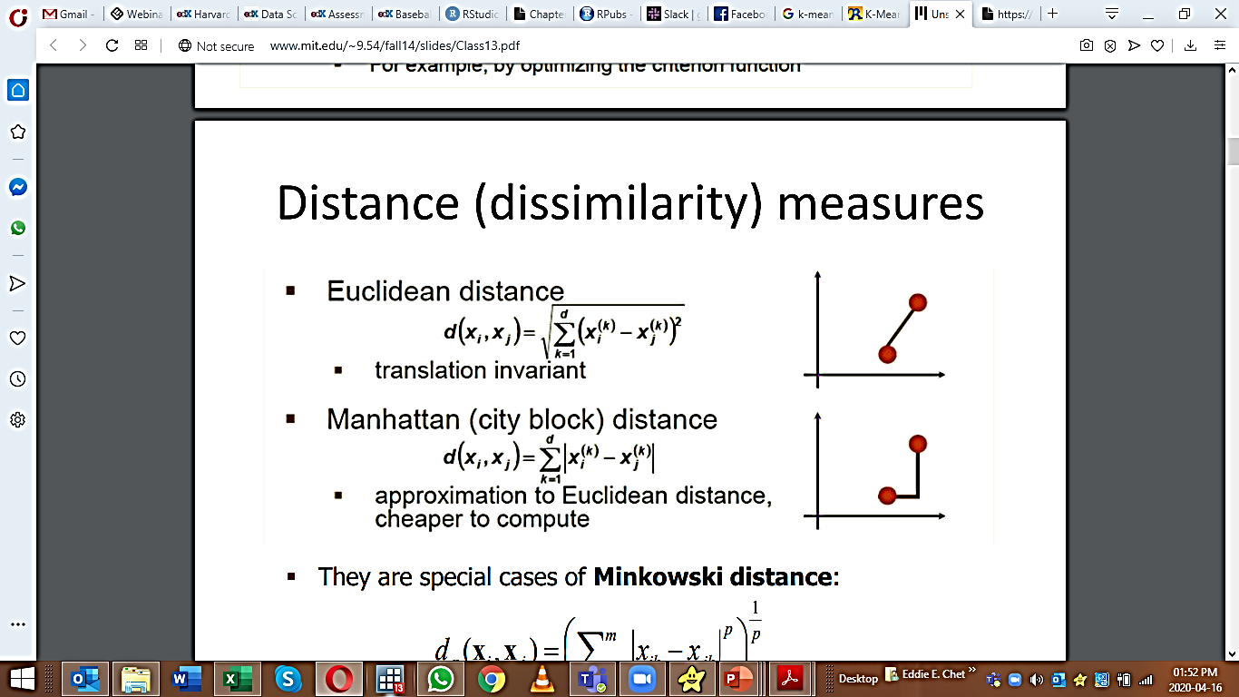
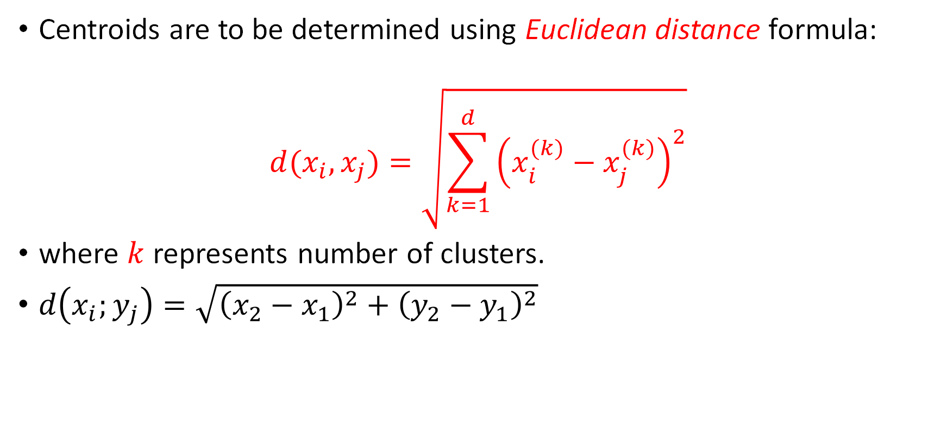
Determining Centroids
Centroids are to be determined using Euclidean distance formula:
$$d(x_{i},x_{j})=\sqrt{\sum_{k=1}^{d}{{\left(x_{i}^{(k)}−x_{j}^{(k)}\right)}^{2}}}$$
where $k$ represents number of clusters.
$d\left(x_{i};y_{j}\right)=\sqrt{{\left(x_{2}−x_{1}\right)}^{2}+{\left(y_{2}−y_{1}\right)}^{2}}$

Slide 45
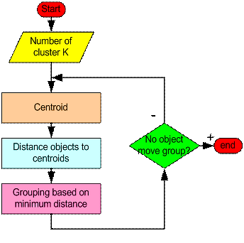
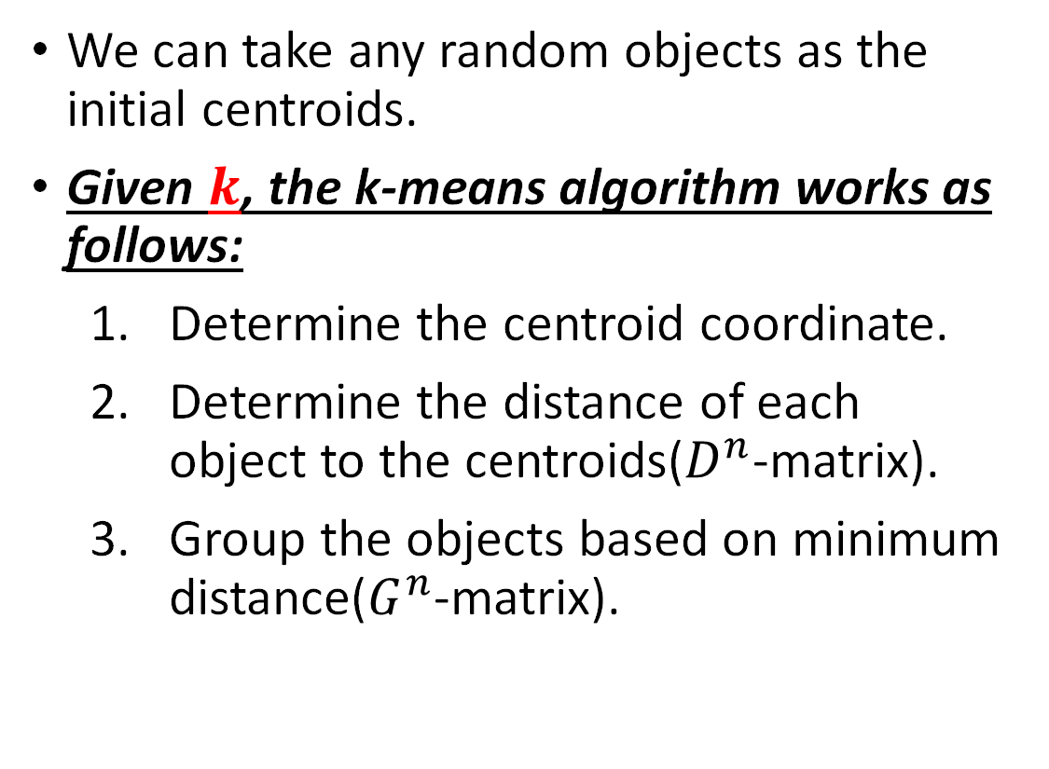
K-means Algorithm
We can take any random objects as the initial centroids.
Given $k$, the k-means algorithm works as follows:
Determine the centroid coordinate.
Determine the distance of each object to the centroids($D^{n}$-matrix).
Group the objects based on minimum distance($G^{n}$-matrix).

Slide 46
K-means Algorithm Example
Suppose we have 4 objects as your training data point and each object have 2 attributes.
Each attribute represents coordinate of the object.
Thus, we also know before hand that these objects belong to two groups of medicine (cluster 1 and cluster 2).
Q: Determine which medicines belong to cluster 1 and which medicines belong to the other cluster?
Each medicine represents one point with two components coordinate as shown below.
Object | Attribute 1: Weight index | Attribute 2: pH
Medicine A | 1 | 1
Medicine B | 2 | 1
Medicine C | 4 | 3
Medicine D | 5 | 4

Slide 47
K-means Algorithm Example
Suppose we have 4 objects as your training data point and each object have 2 attributes.
Each attribute represents coordinate of the object.
Thus, we also know before hand that these objects belong to two groups of medicine (cluster 1 and cluster 2).
Q: Determine which medicines belong to cluster 1 and which medicines belong to the other cluster?
Each medicine represents one point with two components coordinate as shown below.
Object | Attribute 1: Weight index | Attribute 2: pH
Medicine A | 1 | 1
Medicine B | 2 | 1
Medicine C | 4 | 3
Medicine D | 5 | 4

Slide 48
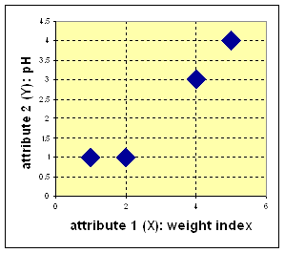
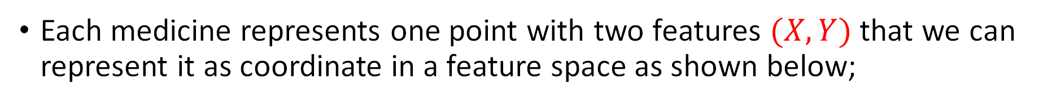
Solution
Each medicine represents one point with two features $(X,Y)$ that we can represent it as coordinate in a feature space as shown below;

Slide 49
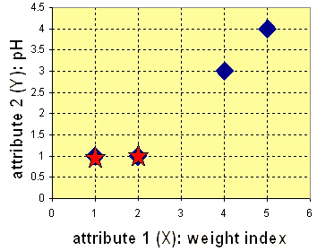
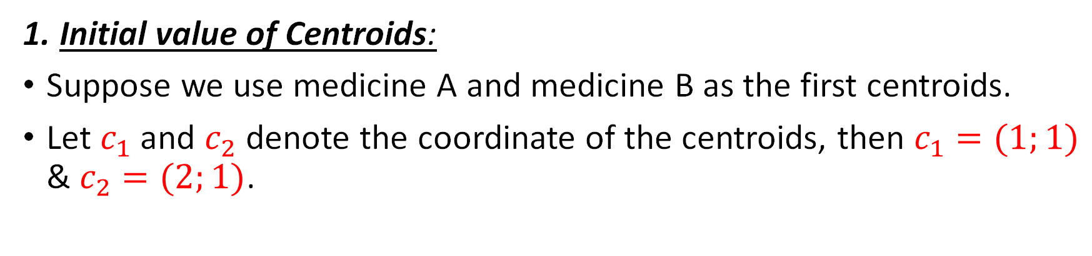
Iteration-0
1. Initial value of Centroids:
Suppose we use medicine A and medicine B as the first centroids.
Let $c_{1}$ and $c_{2}$ denote the coordinate of the centroids, then $c_{1}=(1;1)$ & $c_{2}=(2;1)$.

Slide 50
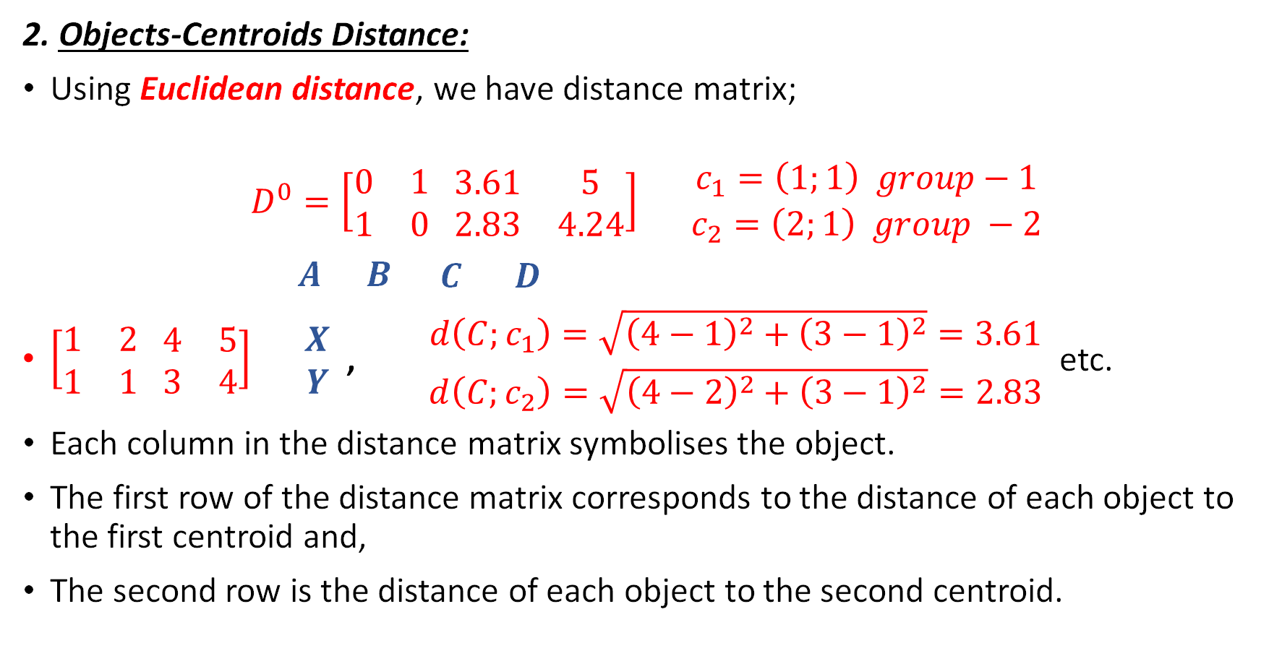
Iteration-0 (Continued)
2. Objects-Centroids Distance:
Using Euclidean distance, we have distance matrix;
$$D^{0}=\left[\begin{matrix}0 & 1 \\ 1 & 0\end{matrix} \begin{matrix}3.61 & 5 \\ 2.83 & 4.24\end{matrix}\right] \begin{matrix}c_{1}=\left(1;1\right) group−1 \\ c_{2}=\left(2;1\right) group −2\end{matrix}$$
$\begin{matrix}A & B \begin{matrix}C & D\end{matrix}\end{matrix}$
$\left[\begin{matrix}1 & 2 \\ 1 & 1\end{matrix} \begin{matrix}4 & 5 \\ 3 & 4\end{matrix}\right] \begin{matrix}X \\ Y\end{matrix}$ , $\begin{matrix}d\left(C;c_{1}\right)=\sqrt{{\left(4−1\right)}^{2}+{\left(3−1\right)}^{2}}=3.61 \\ d\left(C;c_{2}\right)=\sqrt{{\left(4−2\right)}^{2}+{\left(3−1\right)}^{2}}=2.83\end{matrix}$ etc.
Each column in the distance matrix symbolises the object.
The first row of the distance matrix corresponds to the distance of each object to the first centroid and,
The second row is the distance of each object to the second centroid.

Slide 51
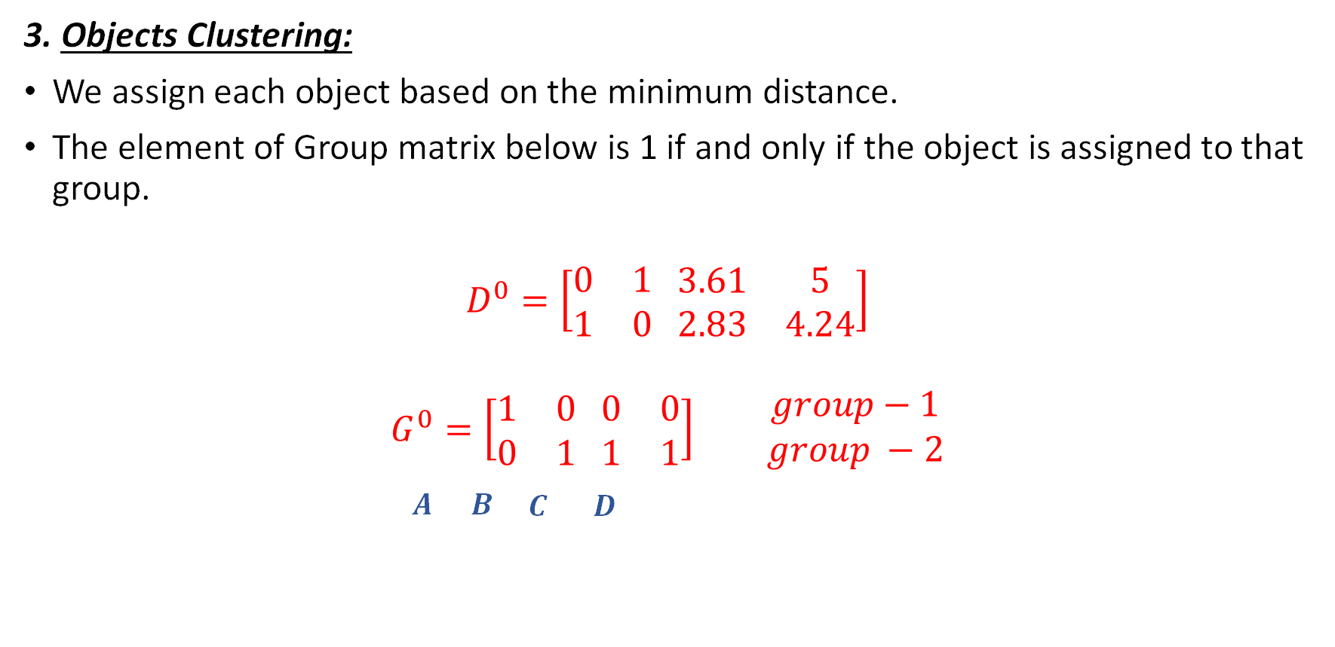
Iteration-0 (Continued)
3. Objects Clustering:
We assign each object based on the minimum distance.
The element of Group matrix below is 1 if and only if the object is assigned to that group.
$$D^{0}=\left[\begin{matrix}0 & 1 \\ 1 & 0\end{matrix} \begin{matrix}3.61 & 5 \\ 2.83 & 4.24\end{matrix}\right]$$
$$G^{0}=\left[\begin{matrix}1 & 0 \\ 0 & 1\end{matrix} \begin{matrix}0 & 0 \\ 1 & 1\end{matrix}\right] \begin{matrix} group−1 \\ group −2\end{matrix}$$
$\begin{matrix}A & B \begin{matrix}C & D\end{matrix}\end{matrix}$

Slide 52
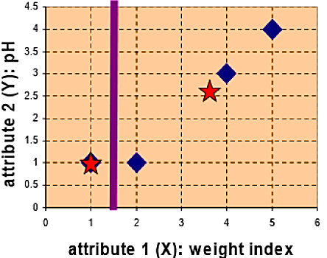
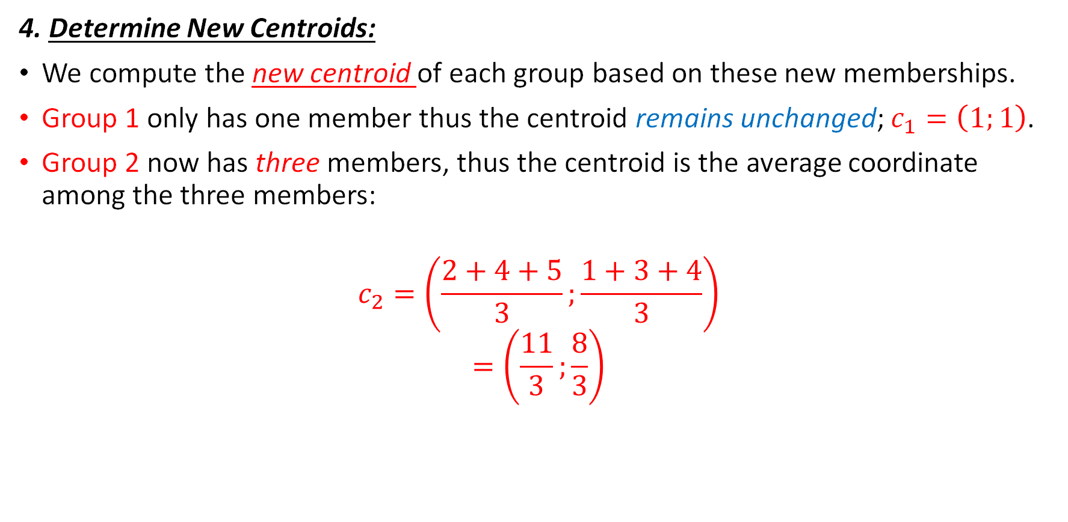
Iteration-1
4. Determine New Centroids:
We compute the new centroid of each group based on these new memberships.
Group 1 only has one member thus the centroid remains unchanged; $c_{1}=\left(1;1\right)$.
Group 2 now has three members, thus the centroid is the average coordinate among the three members:
$$c_{2}=\left(\frac{2+4+5}{3};\frac{1+3+4}{3}\right)$$
$$=\left(\frac{11}{3};\frac{8}{3}\right)$$

Slide 53
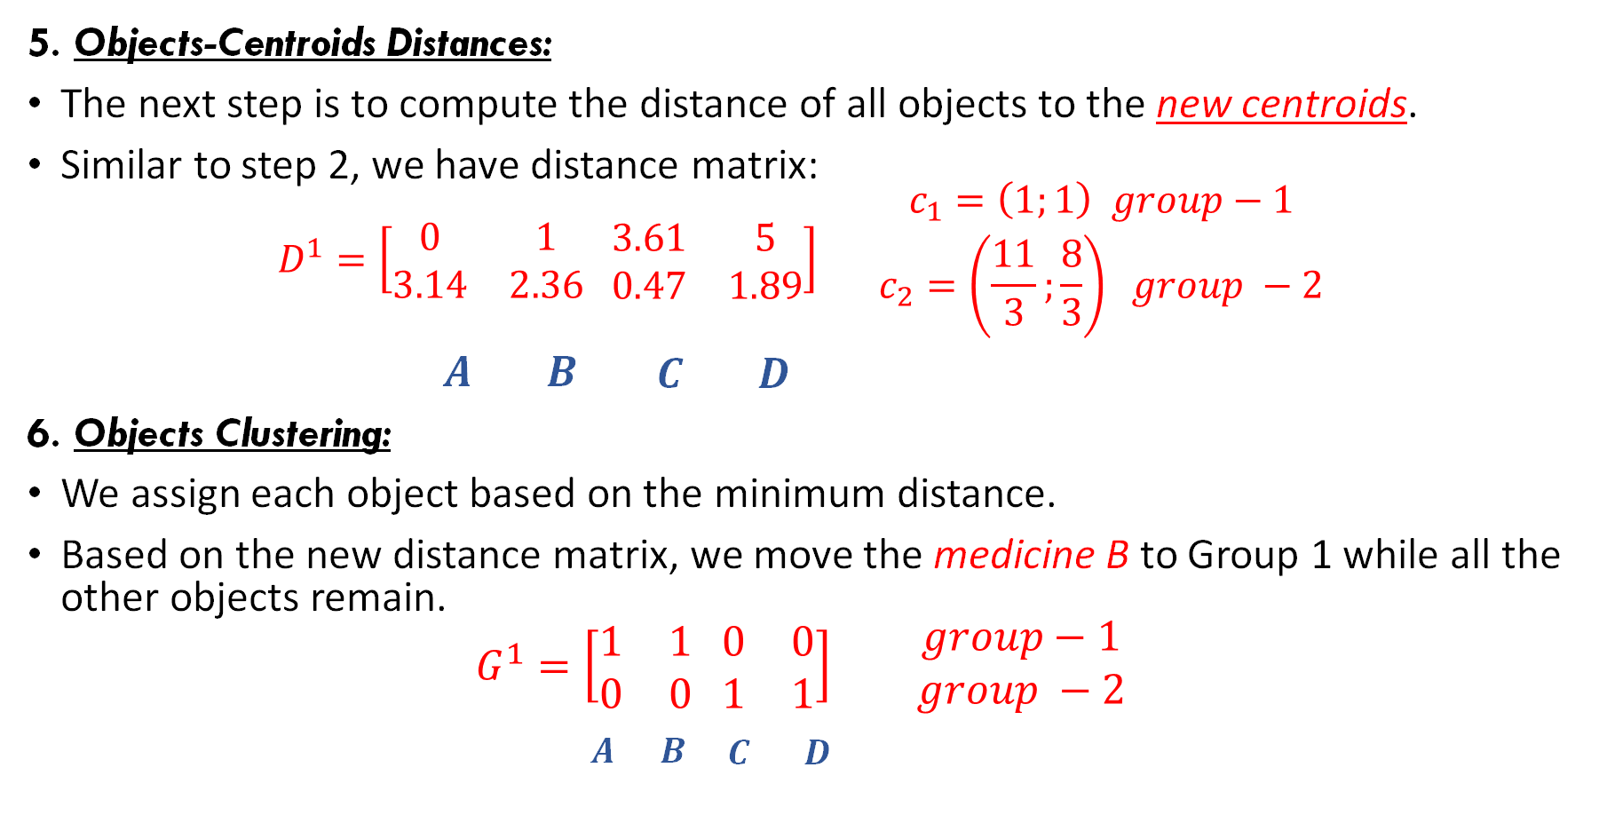
Iteration-1 (Continued)
5. Objects-Centroids Distances:
The next step is to compute the distance of all objects to the new centroids.
Similar to step 2, we have distance matrix:
$$D^{1}=\left[\begin{matrix}0 & 1 \\ 3.14 & 2.36\end{matrix} \begin{matrix}3.61 & 5 \\ 0.47 & 1.89\end{matrix}\right] \begin{matrix}c_{1}=\left(1;1\right) group−1 \\ c_{2}=\left(\frac{11}{3};\frac{8}{3}\right) group −2\end{matrix}$$
$\begin{matrix}A & B \begin{matrix}C & D\end{matrix}\end{matrix}$
6. Objects Clustering:
We assign each object based on the minimum distance.
Based on the new distance matrix, we move the medicine B to Group 1 while all the other objects remain.
$$G^{1}=\left[\begin{matrix}1 & 1 \\ 0 & 0\end{matrix} \begin{matrix}0 & 0 \\ 1 & 1\end{matrix}\right] \begin{matrix} group−1 \\ group −2\end{matrix}$$
$\begin{matrix}A & B \begin{matrix}C & D\end{matrix}\end{matrix}$

Slide 54
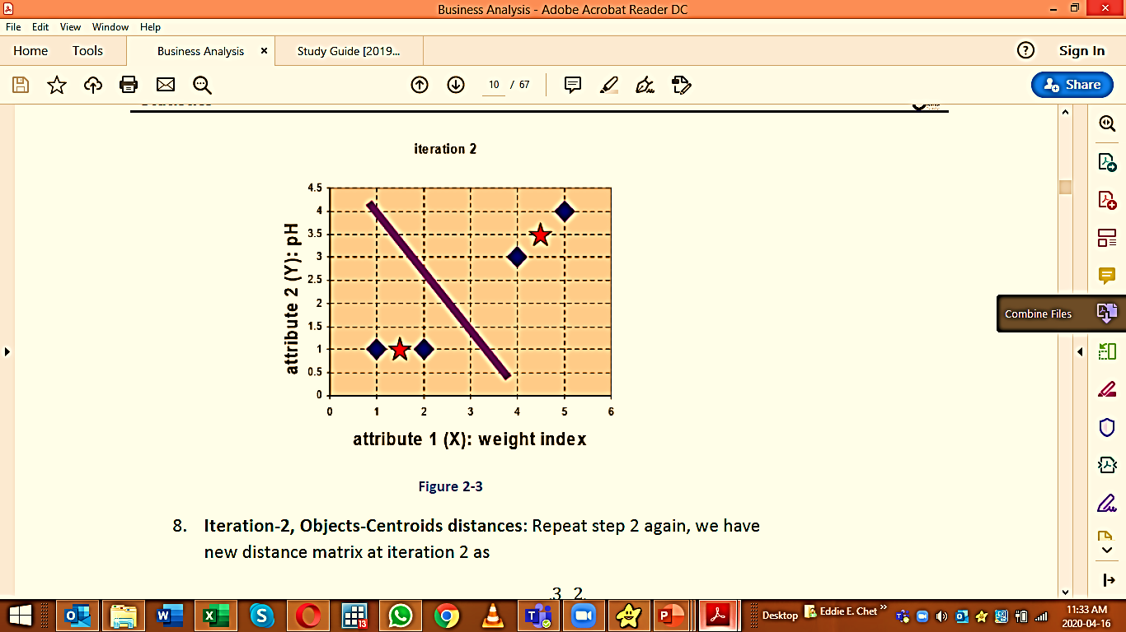
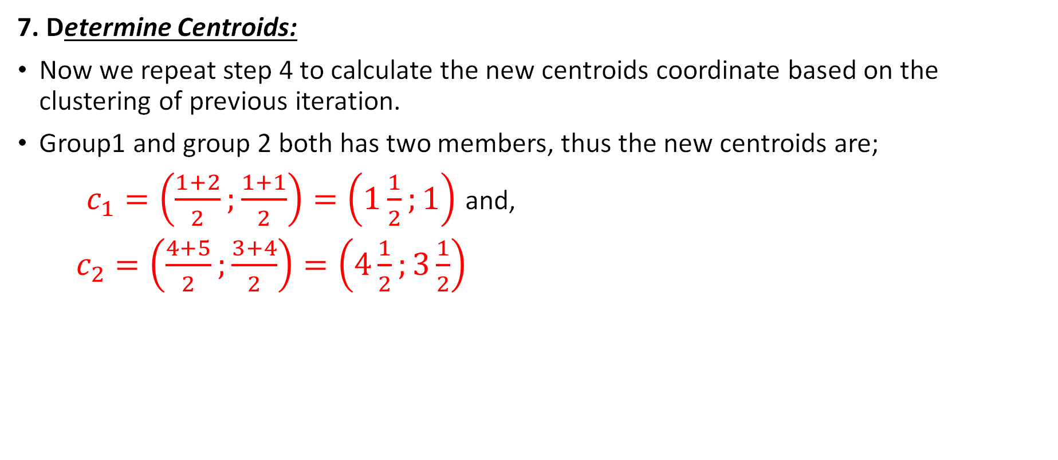
Iteration-2
7. Determine Centroids:
Now we repeat step 4 to calculate the new centroids coordinate based on the clustering of previous iteration.
Group1 and group 2 both has two members, thus the new centroids are;
$c_{1}=\left(\frac{1+2}{2};\frac{1+1}{2}\right)=\left(1\frac{1}{2};1\right)$ and,
$c_{2}=\left(\frac{4+5}{2};\frac{3+4}{2}\right)=\left(4\frac{1}{2};3\frac{1}{2}\right)$

Slide 55
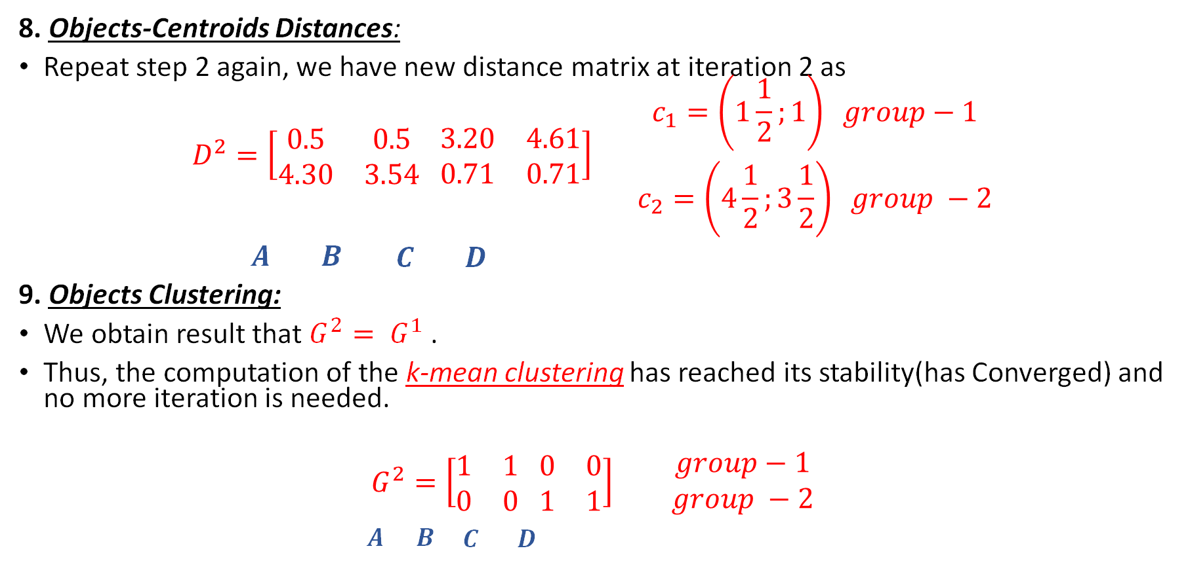
Iteration-2 (Continued)
8. Objects-Centroids Distances:
Repeat step 2 again, we have new distance matrix at iteration 2 as
$$D^{2}=\left[\begin{matrix}0.5 & 0.5 \\ 4.30 & 3.54\end{matrix} \begin{matrix}3.20 & 4.61 \\ 0.71 & 0.71\end{matrix}\right] \begin{matrix}c_{1}=\left(1\frac{1}{2};1\right) group−1 \\ c_{2}=\left(4\frac{1}{2};3\frac{1}{2}\right) group −2\end{matrix}$$
$\begin{matrix}A & B \begin{matrix}C & D\end{matrix}\end{matrix}$
9. Objects Clustering:
We obtain result that $G^{2}= G^{1}$.
Thus, the computation of the k-mean clustering has reached its stability(has Converged) and no more iteration is needed.
$$G^{2}=\left[\begin{matrix}1 & 1 \\ 0 & 0\end{matrix} \begin{matrix}0 & 0 \\ 1 & 1\end{matrix}\right] \begin{matrix} group−1 \\ group −2\end{matrix}$$
$\begin{matrix}A & B \begin{matrix}C & D\end{matrix}\end{matrix}$

Slide 56
Final Result:
We get the final grouping as the results;
Group 1: Medicine A and B
Group 2: Medicine C and D.
Object | Feature 1: Weight index | Feature 2: pH | Group (Results)
Medicine A | 1 | 1 | 1
Medicine B | 2 | 1 | 1
Medicine C | 4 | 3 | 2
Medicine D | 5 | 4 | 2

Slide 57
Final Solution
Group1{A; B} c1(1.5; 1)
Group2{C; D} c2(4.5; 3.5)

Slide 58
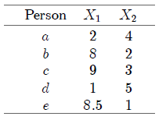
Cluster Analysis Exercise
Cluster analysis embraces a variety of techniques, the main objective of which is to group observations or variables into homogeneous and distinct clusters.
The daily expenditures on food (X1) and clothing (X2) of five persons is given below. Use the k means algorithm to cluster them.

Slide 59
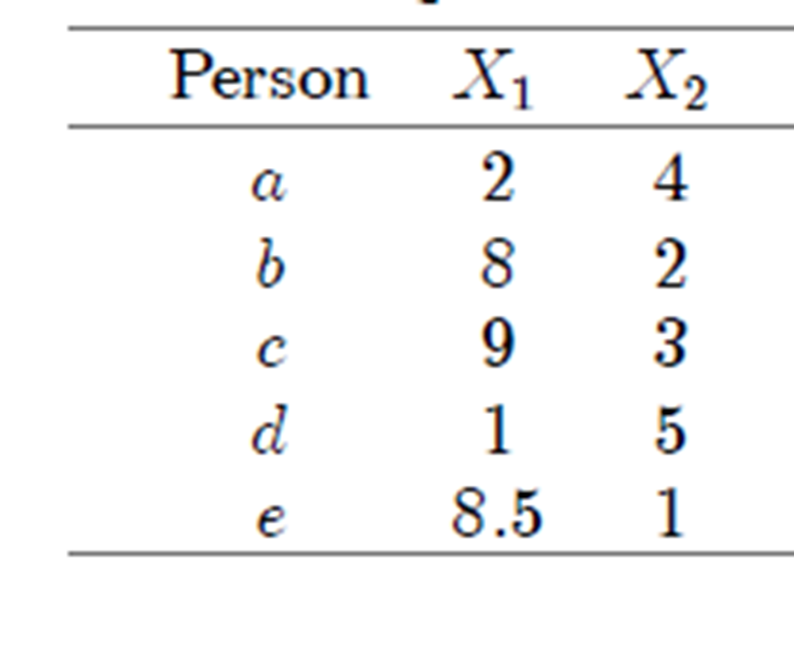
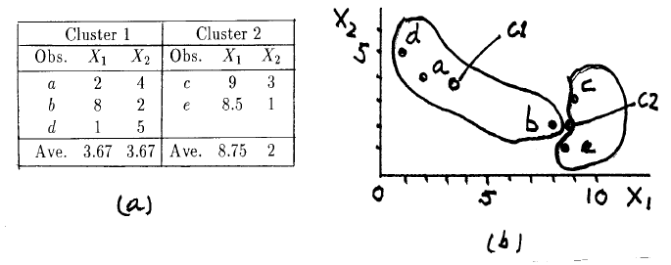
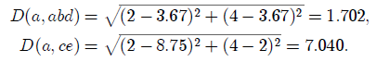
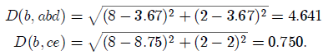
(k-means method)
Suppose two clusters are to be formed
First assign a, b and d to Cluster 1,
Next assign c and e to Cluster 2.
Calculate cluster centroids
Centroid of Cluster 1 is
the point (X1 = 3:67, X2 = 3:67),
The cluster centroid is the point with coordinates equal to the average values of the variables for the observations in that cluster
calculate the distance between a and the two centroids:
a is closer to the centroid of Cluster 1, to which it is currently assigned. a is not reassigned
calculate the distance
between b and the two cluster centroids:
Since b is closer to Cluster 2's centroid than to that of Cluster 1, it is reassigned to Cluster 2.

Slide 60
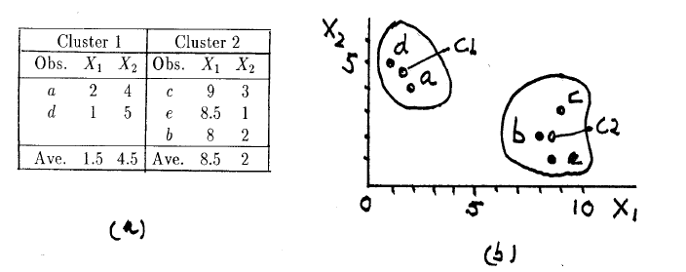
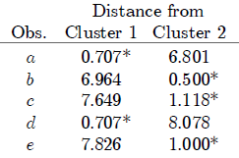
(k-means method)
New cluster centroids
New cluster centroids
Every observation belongs to the cluster to the centroid of which it is nearest, and the k-means method stops.

Slide 61
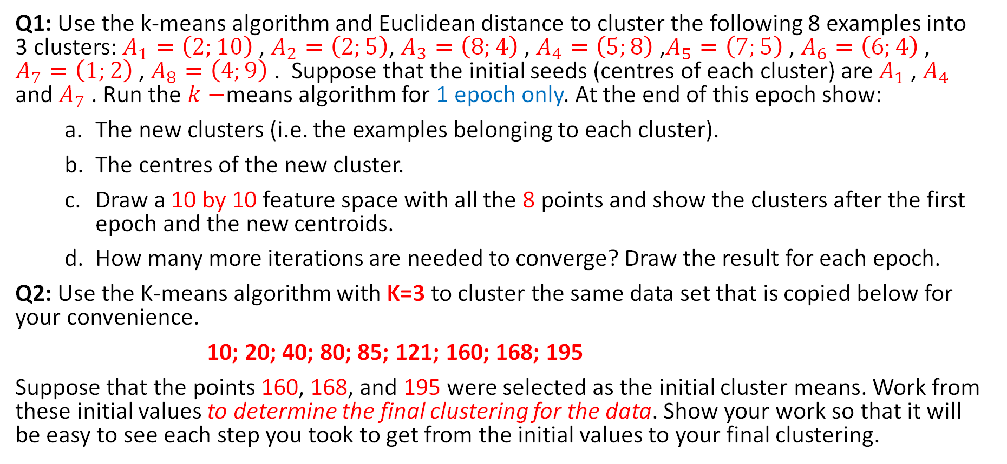
Exercises
Q1: Use the k-means algorithm and Euclidean distance to cluster the following 8 examples into 3 clusters: $A_{1}=\left(2;10\right)$, $A_{2}=\left(2;5\right)$, $A_{3}=\left(8;4\right)$, $A_{4}=\left(5;8\right)$,$A_{5}=\left(7;5\right)$, $A_{6}=\left(6;4\right)$, $A_{7}=\left(1;2\right)$, $A_{8}=\left(4;9\right)$. Suppose that the initial seeds (centres of each cluster) are $A_{1}$, $A_{4}$ and $A_{7}$. Run the $k−$means algorithm for 1 epoch only. At the end of this epoch show:
The new clusters (i.e. the examples belonging to each cluster).
The centres of the new cluster.
Draw a 10 by 10 feature space with all the 8 points and show the clusters after the first epoch and the new centroids.
How many more iterations are needed to converge? Draw the result for each epoch.
Q2: Use the K-means algorithm with K=3 to cluster the same data set that is copied below for your convenience.
10; 20; 40; 80; 85; 121; 160; 168; 195
Suppose that the points 160, 168, and 195 were selected as the initial cluster means. Work from these initial values to determine the final clustering for the data. Show your work so that it will be easy to see each step you took to get from the initial values to your final clustering.

Slide 62
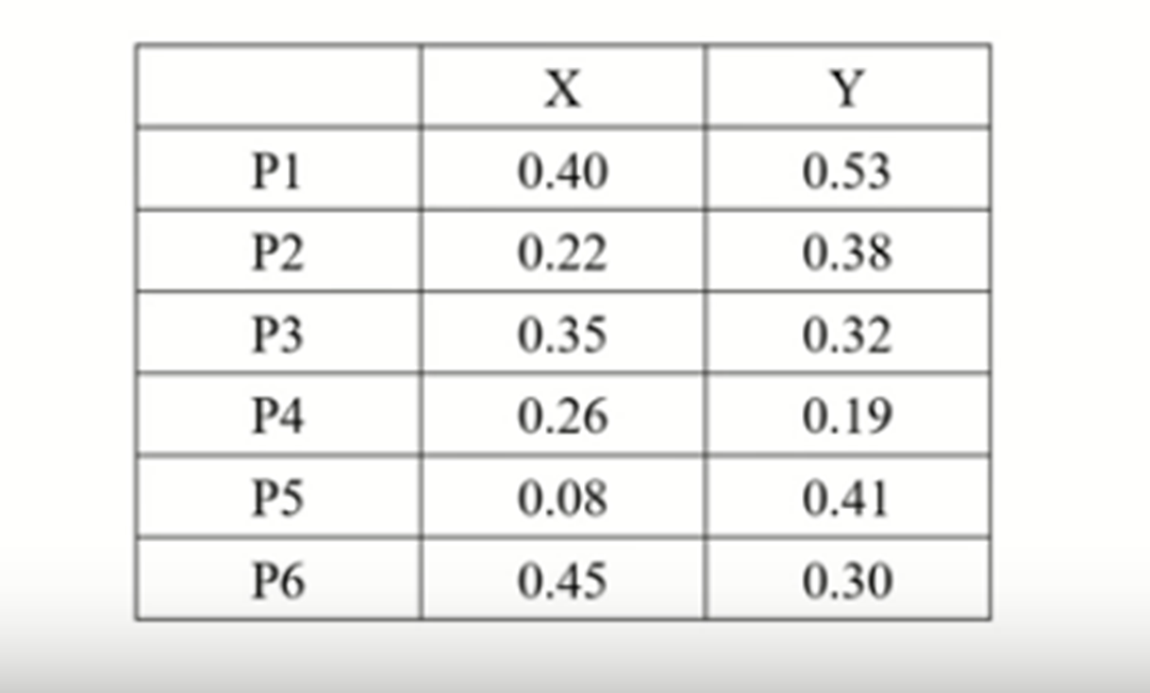
Exs. No. 3

